Slide 1
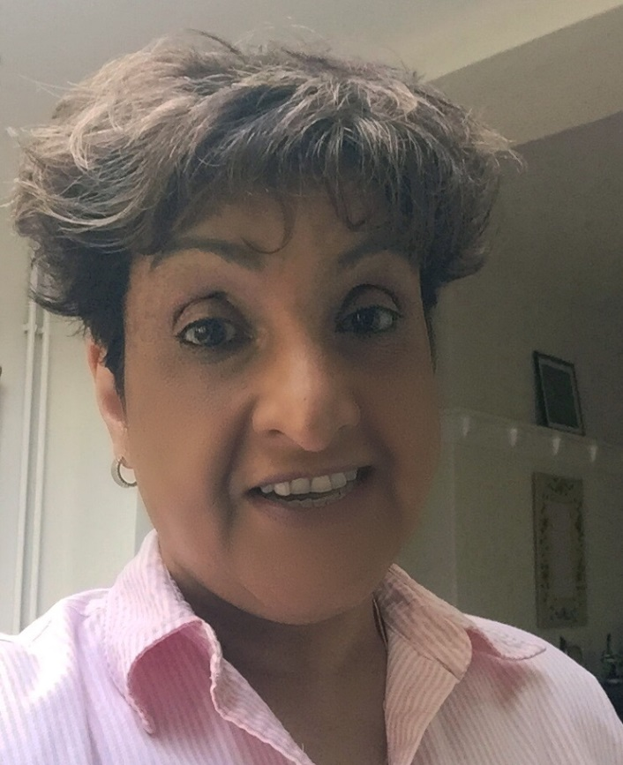
Rukhsana Mir
Photo courtesy of Ruksana Mir. Copyright Ton-yr-Ywen Primary

Slide 2
Rukhsana
She was 5 years old when she came to Wales. She used to live in Kenya. She came over for better education. She got here by plane
It took her 8 hours .
She came with her mum, dad, 2 brothers and 3 sisters.
In Kenya school was very similar. In Kenya it was very hot.

Slide 3
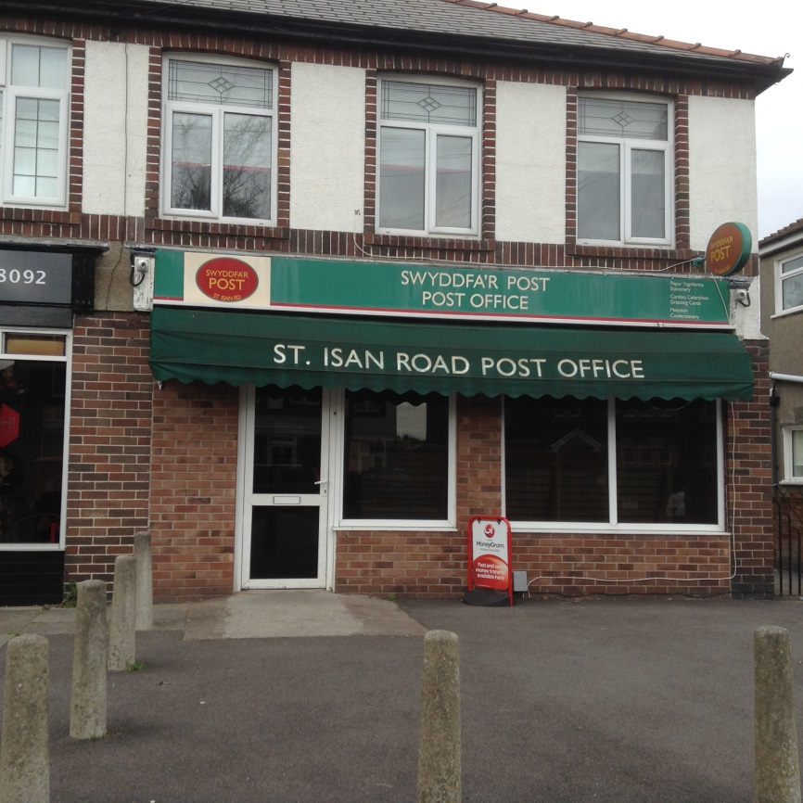
Today
She works in a post office on St Isan road in The Heath. It was scary emigrating to Cardiff but she’s settled now

